Slide 1

Acceleration Time Graph
Acceleration time graphs depict the relationship between acceleration and time.
These graphs are fundamental tools in physics and engineering, providing insights into the motion of objects.
Find more slides on : www.ecosystemforkids.com

Slide 2

Introduction to Acceleration
Acceleration is a fundamental concept in physics.
It describes the rate at which an object's velocity changes over time.
Acceleration can be positive or negative, representing a change in speed or direction.

Slide 3
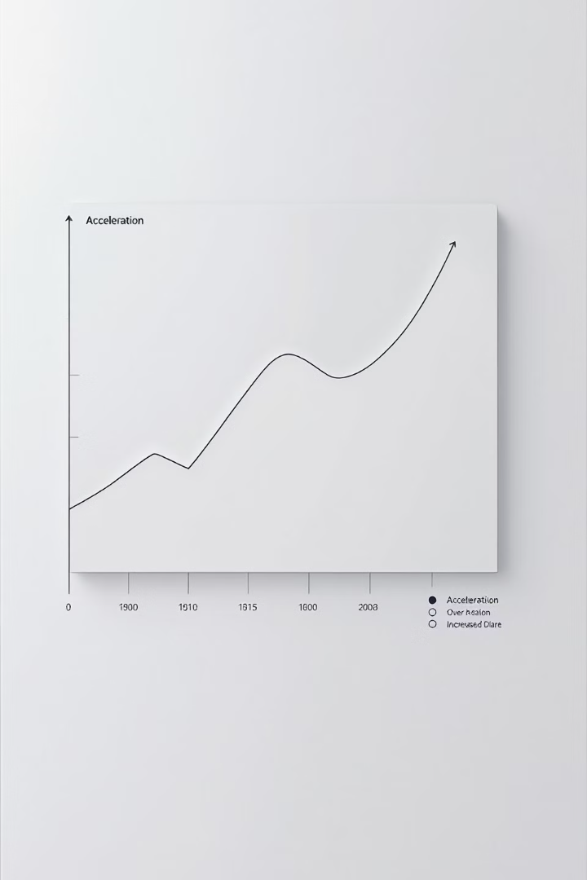



Defining Acceleration
Rate of Change
Acceleration is a measure of how quickly an object's velocity changes.
Velocity
Acceleration involves a change in speed, direction, or both.
Vector Quantity
Acceleration has both magnitude and direction.

Slide 4
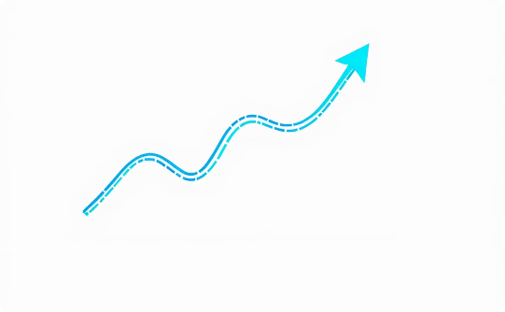
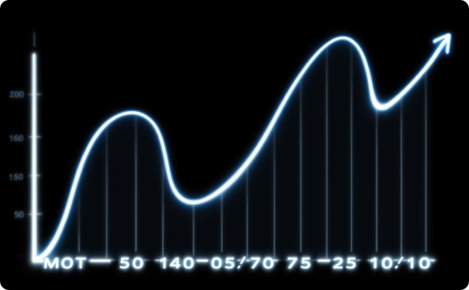

Types of Acceleration
Constant Acceleration
Variable Acceleration
Instantaneous Acceleration
Occurs when the velocity of an object changes at a uniform rate. This means the object is gaining or losing speed consistently over time.
Occurs when the velocity of an object changes at a non-uniform rate. This means the object's speed is not changing consistently over time.
The rate of change of velocity at a specific point in time. This is a measure of how quickly the velocity is changing at that moment.

Slide 5

Constant Acceleration
Definition
Examples
Constant acceleration means an object's velocity changes at a steady rate. The speed increases or decreases uniformly over time.
A car accelerating from rest on a straight road, or a ball falling freely under gravity, are examples of constant acceleration.
Graphical Representation
Equations of Motion
A constant acceleration is represented by a straight line on a velocity-time graph, with the slope of the line indicating the magnitude of the acceleration.
Specific equations can be used to calculate displacement, velocity, and time in situations involving constant acceleration.

Slide 6
Instantaneous Acceleration
A Moment in Time
Calculated with Derivatives
Instantaneous acceleration refers to the acceleration of an object at a specific point in time.
Instantaneous acceleration is calculated using calculus, specifically the derivative of the velocity function.
It is the rate of change of velocity at that instant.
This gives us the instantaneous rate of change of velocity at any given time.

Slide 7
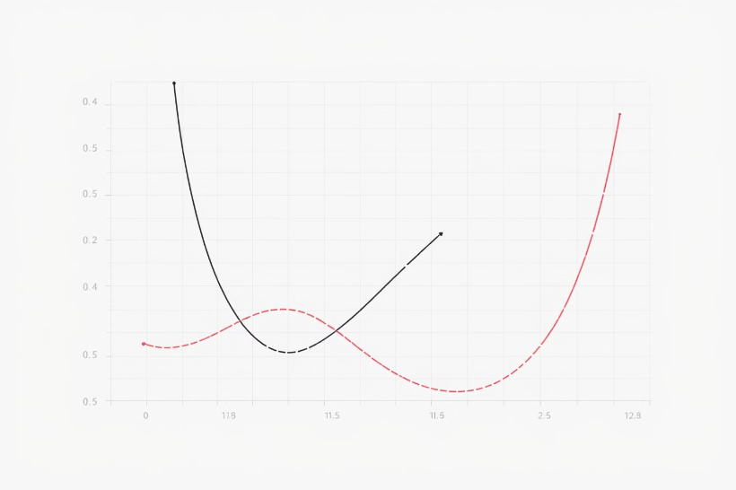
Acceleration Time Graphs
Acceleration time graphs are powerful tools for visualizing and analyzing the acceleration of an object over time.
The graph's shape provides insights into the object's motion, including its speed, direction, and changes in acceleration.

Slide 8

Understanding Acceleration Time Graphs
1
Slope
The slope of the line represents the acceleration of the object. A steeper slope indicates a higher acceleration.
2
Area
The area under the curve represents the change in velocity over time. A larger area indicates a greater change in velocity.
3
Intercepts
The y-intercept represents the initial velocity of the object. The x-intercept represents the time at which the object comes to rest.

Slide 9
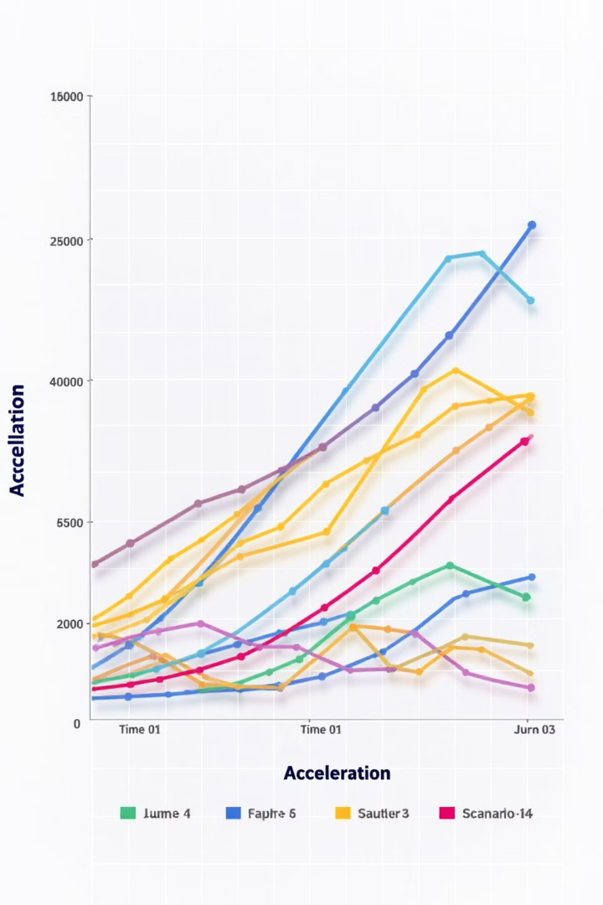




Analyzing Acceleration Time Graphs
Slope
The slope of an acceleration-time graph represents the instantaneous acceleration at a specific point in time.
Area
The area under the curve of an acceleration-time graph represents the change in velocity over a given time interval.
Shape
The shape of the graph provides insights into the nature of the motion. For example, a linear graph indicates constant acceleration, while a curved graph indicates changing acceleration.
Integration
Mathematical integration can be used to determine the velocity and displacement of an object from an acceleration-time graph.

Slide 10

Acceleration Formulas and Calculations
1
Calculating Acceleration
2
Newton's Second Law
Acceleration is calculated by dividing the change in velocity by the change in time.
Newton's Second Law of Motion states that the force acting on an object is equal to its mass times its acceleration.
3
Constant Acceleration Formulas
4
Non-Uniform Acceleration
For non-uniform acceleration, calculus is often used to calculate the acceleration, velocity, and displacement over a specific time interval.
For uniform motion, there are specific equations to calculate displacement, final velocity, and time based on initial velocity and acceleration.

Slide 11
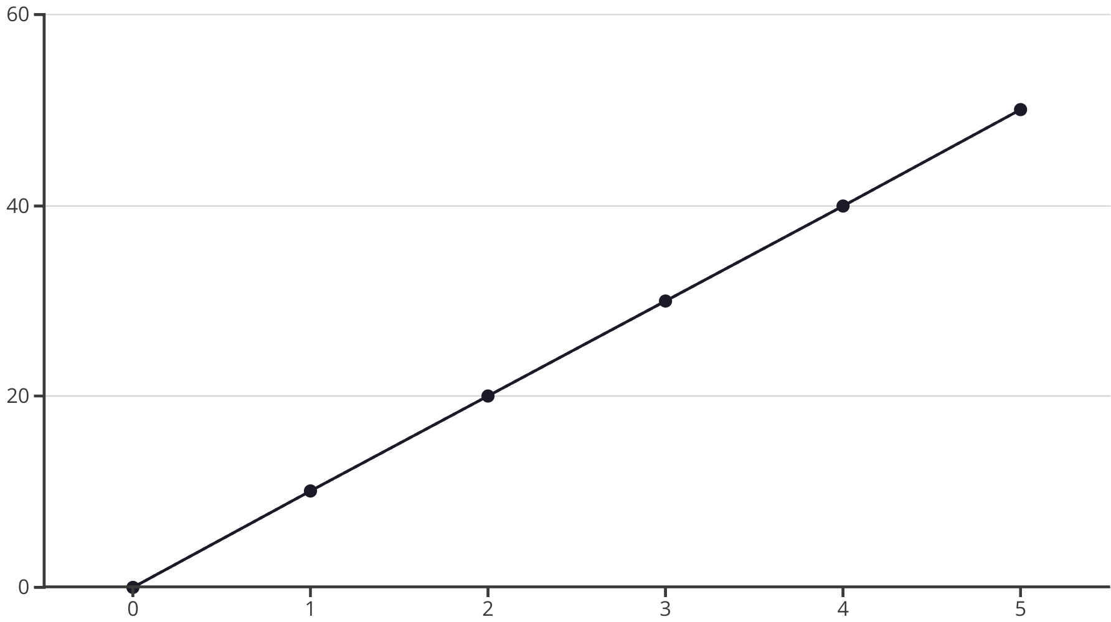
Velocity-Time Relationship
The velocity-time graph displays the relationship between the object's velocity and time.
The slope of the line represents the acceleration.

Slide 12

Displacement-Time Relationship
Acceleration
Displacement
Constant
Parabolic
Variable
Non-Parabolic
The relationship between displacement and time is influenced by the nature of acceleration.
Constant acceleration leads to a parabolic displacement-time graph, while variable acceleration results in a non-parabolic curve.

Slide 13
Interpreting Acceleration Time Graphs
Slope
1
Represents instantaneous velocity.
Area
2
Represents change in velocity.
Zero Slope
3
Indicates constant velocity.
Curvature
4
Represents whether acceleration is increasing or decreasing.
Acceleration time graphs are valuable tools for understanding the motion of objects. The slope of the line at any point on the graph represents the instantaneous velocity. The area under the curve represents the change in velocity.

Slide 14

Positive and Negative Acceleration
Positive Acceleration
Negative Acceleration
Positive acceleration indicates an increase in velocity. This means that the object is speeding up.
Negative acceleration indicates a decrease in velocity. This means that the object is slowing down.
The direction of motion and the direction of acceleration are the same.
The direction of motion and the direction of acceleration are opposite.

Slide 15
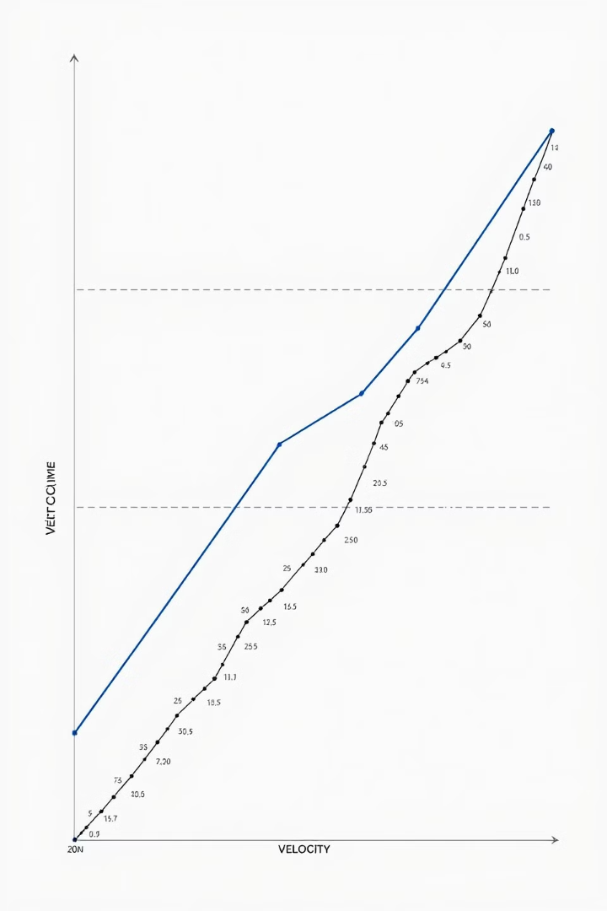
Uniform Acceleration
1
Constant Rate
2
Linear Change
Uniform acceleration describes an object's velocity changing by the same amount over equal time intervals.
The velocity-time graph for uniform acceleration is a straight line, indicating a consistent rate of change.
3
Examples
A car accelerating from rest at a steady rate or a ball falling freely under gravity exhibit uniform acceleration.

Slide 16





Non-Uniform Acceleration
Changing Rate
Variable Velocity
Acceleration varies over time.
Velocity changes at a non-constant rate.
Curved Graph
Real-World Examples
Acceleration-time graph is not a straight line.
A car starting from rest and gradually accelerating, then slowing down before coming to a stop.

Slide 17



Acceleration in One-Dimensional Motion
One-dimensional motion refers to the movement of an object along a straight line. The acceleration of an object in one dimension is the rate at which its velocity changes.
Linear Acceleration
1
The acceleration is constant and in the same direction as the velocity.
Deceleration
2
The acceleration is opposite to the direction of the velocity.
Variable Acceleration
3
The acceleration changes over time.
Understanding the acceleration in one dimension is crucial for analyzing the motion of objects in simple scenarios. This knowledge lays the foundation for understanding more complex motion in two or three dimensions.

Slide 18
Acceleration in Two-Dimensional Motion
1
Projectile Motion
Acceleration in two dimensions is crucial for understanding projectile motion, where objects move in both the horizontal and vertical directions. The gravitational force acts as the acceleration in the vertical direction.
2
Circular Motion
In circular motion, objects accelerate towards the center of the circle, known as centripetal acceleration. This acceleration is responsible for keeping the object moving in a circular path.
3
Curvilinear Motion
Any motion that follows a curved path involves acceleration in two dimensions. The acceleration can be decomposed into components tangent to the path and perpendicular to the path.

Slide 19



Applications of Acceleration Time Graphs
Automotive Engineering
Aerospace
Sports Analysis
Acceleration time graphs are used to analyze vehicle performance, design optimized engines, and improve safety.
Graphs help engineers understand the dynamics of spacecraft, optimize launch trajectories, and ensure safe re-entry.
These graphs help coaches analyze athlete performance, identify strengths and weaknesses, and improve training strategies.

Slide 20

Importance of Acceleration Time Graphs
Analyze Motion
Predict Future Behavior
Acceleration time graphs provide a visual representation of an object's motion, revealing its speed and direction changes over time.
By analyzing the graph's slope and area, we can predict the object's velocity and displacement at any given time.
Calculate Acceleration
Problem-Solving
Graphs allow for precise measurement of acceleration, which is crucial for understanding the forces acting on an object.
They are invaluable tools for solving physics problems, allowing us to understand the relationship between acceleration, velocity, and displacement.

Slide 21
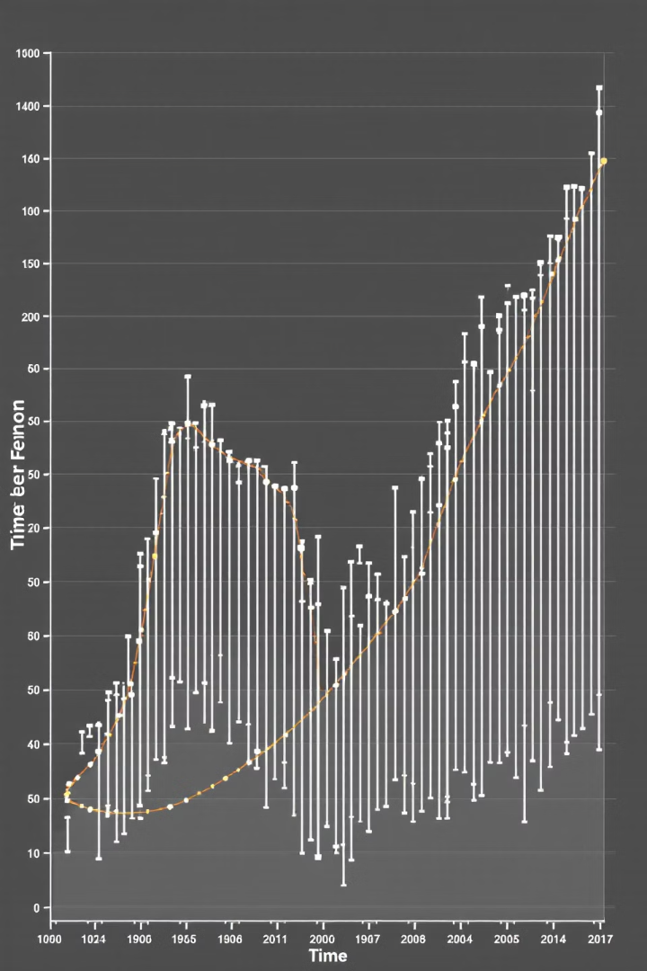
Conclusion and Key Takeaways
Understanding Acceleration
Visualizing Motion
These graphs are powerful tools for understanding and analyzing complex motion patterns, whether in physics, engineering, or other scientific fields.
Acceleration time graphs provide insights into the motion of objects. These graphs are essential tools for understanding how velocity changes over time.
Applications in Various Fields
Acceleration time graphs find applications in various fields such as physics, engineering, and sports, helping us understand motion and improve performance.

