Slide 1
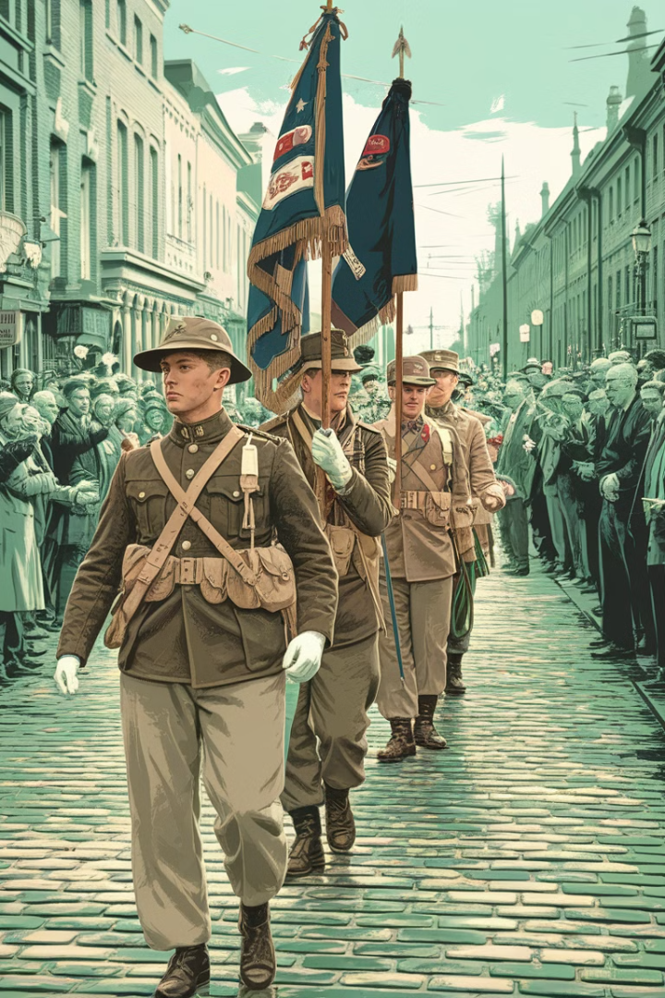

The United States in World War I
From a reluctant outsider to a decisive force, the United States' involvement in World War I marked a pivotal moment in its rise as a global superpower. This presentation will explore the key events and consequences of America's entry into the "Great War".
par Math Fox

Slide 2
Causes of U.S. Involvement
Sinking of the Lusitania
Unrestricted Submarine Warfare
Zimmermann Telegram
Ideological Factors
The German torpedoing of the British passenger liner Lusitania, resulting in the deaths of over 100 Americans, outraged public opinion.
A secret proposal from Germany to Mexico to attack the U.S. was intercepted, galvanizing American sentiment for war.
President Woodrow Wilson's vision of making the world "safe for democracy" motivated the U.S. to join the Allied cause.
Germany's policy of attacking all ships, including those from neutral countries, further strained relations with the U.S.

Slide 3

U.S. Mobilization and Preparation
1
Conscription Act
The U.S. instituted a draft, calling up millions of men for military service.
2
Training Camps
New training camps were established across the country to prepare the influx of recruits.
3
Industrial Mobilization
American factories were quickly retooled to produce the weapons, supplies, and equipment needed for the war effort.

Slide 4
The Battle of Cantigny
First Major U.S. Offensive
Tactical Victory
Boosting Morale
Strategic Importance
U.S. forces successfully captured the town of Cantigny from the Germans, demonstrating their abilities on the battlefield.
The victory at Cantigny was a much-needed confidence boost for the American Expeditionary Forces.
The Battle of Cantigny in May 1918 marked the first significant American-led combat operation of the war.
The battle highlighted the growing role of the U.S. military in the final stages of the war.

Slide 5
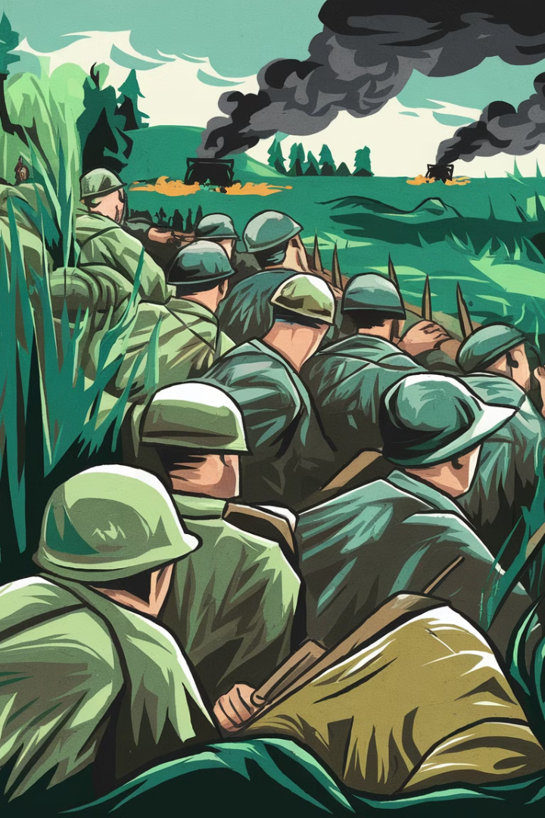



The Battle of Château-Thierry
German Spring Offensive
In the spring of 1918, the Germans launched a massive offensive, pushing deep into French territory.
American Reinforcements
U.S. troops were rushed to the Château-Thierry sector to help stop the German advance.
Halting the Offensive
The American forces, alongside French and British troops, were able to halt the German offensive and push them back.

Slide 6






The Battle of St. Mihiel
1
Careful Planning
2
Massive Coordinated Assault
3
Successful Penetration
4
Capture of Key Territory
5
Boost to American Confidence
The Battle of St. Mihiel in September 1918 marked the first major offensive led entirely by American forces. The carefully planned and executed attack resulted in the capture of the strategic St. Mihiel salient, delivering a significant morale boost to the American Expeditionary Forces.
6

Slide 7
The Meuse-Argonne Offensive
1
Largest American Operation
2
Overcoming Initial Setbacks
3
Grinding German Resistance
4
Final Allied Victory
The Meuse-Argonne Offensive, launched in September 1918, was the largest American military operation of the war. Despite initial setbacks, the American forces, supported by their Allies, persevered through the German defenses, eventually breaking through and contributing significantly to the Allied victory.
5

Slide 8

The Impact of American Involvement
1
Tipping the Balance
2
Emergence as a Global Power
The arrival of over 2 million American troops played a decisive role in shifting the tide of the war in favor of the Allies.
The U.S. firmly established itself as a major world power, both militarily and economically, after its successful intervention in the war.
3
Woodrow Wilson's Vision
4
Lasting Legacy
The American role in World War I had a profound impact on the country's identity, foreign policy, and its place on the world stage.
President Wilson's idealistic goals, such as the League of Nations, shaped the postwar diplomatic landscape, though they faced significant challenges.

