Slide 1
Photosynthesis
www.ecosystemforkids.com
K – 7 Science Resources

Slide 2
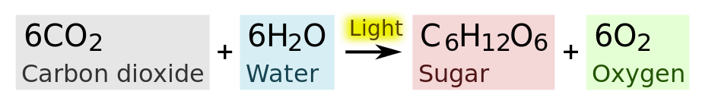
What is photosynthesis ?
Photosynthesis is a process used by plants and other organisms to convert light energy into chemical energy that can later be released to fuel the organisms' activities (energy transformation). This chemical energy is stored in carbohydrate molecules, such as sugars, which are synthesized from carbon dioxide and water – hence the name photosynthesis.

Slide 3
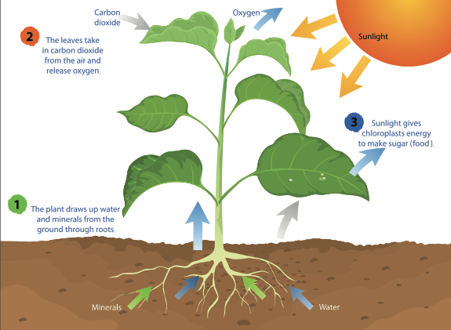
What is photosynthesis ?
Source: mapichai/Shutterstock.com

Slide 4
What happens during the process.
During photosynthesis, plant roots take up water and minerals from the soil while their leaves absorb carbon dioxide from the atmosphere and sunlight. All these elements combine during the process to produce carbohydrates. Also, during the process, oxygen is released into the atmosphere.

Slide 5
Take a test
During _______, plant roots take up water and minerals from the soil while their leaves absorb ________from the atmosphere and sunlight. All these elements combine during the process to produce _______. Also, during the process, ______ is released into the ________.

Slide 6
Photosynthesis
www.ecosystemforkids.com
K – 7 Science Resources

