Slide 1
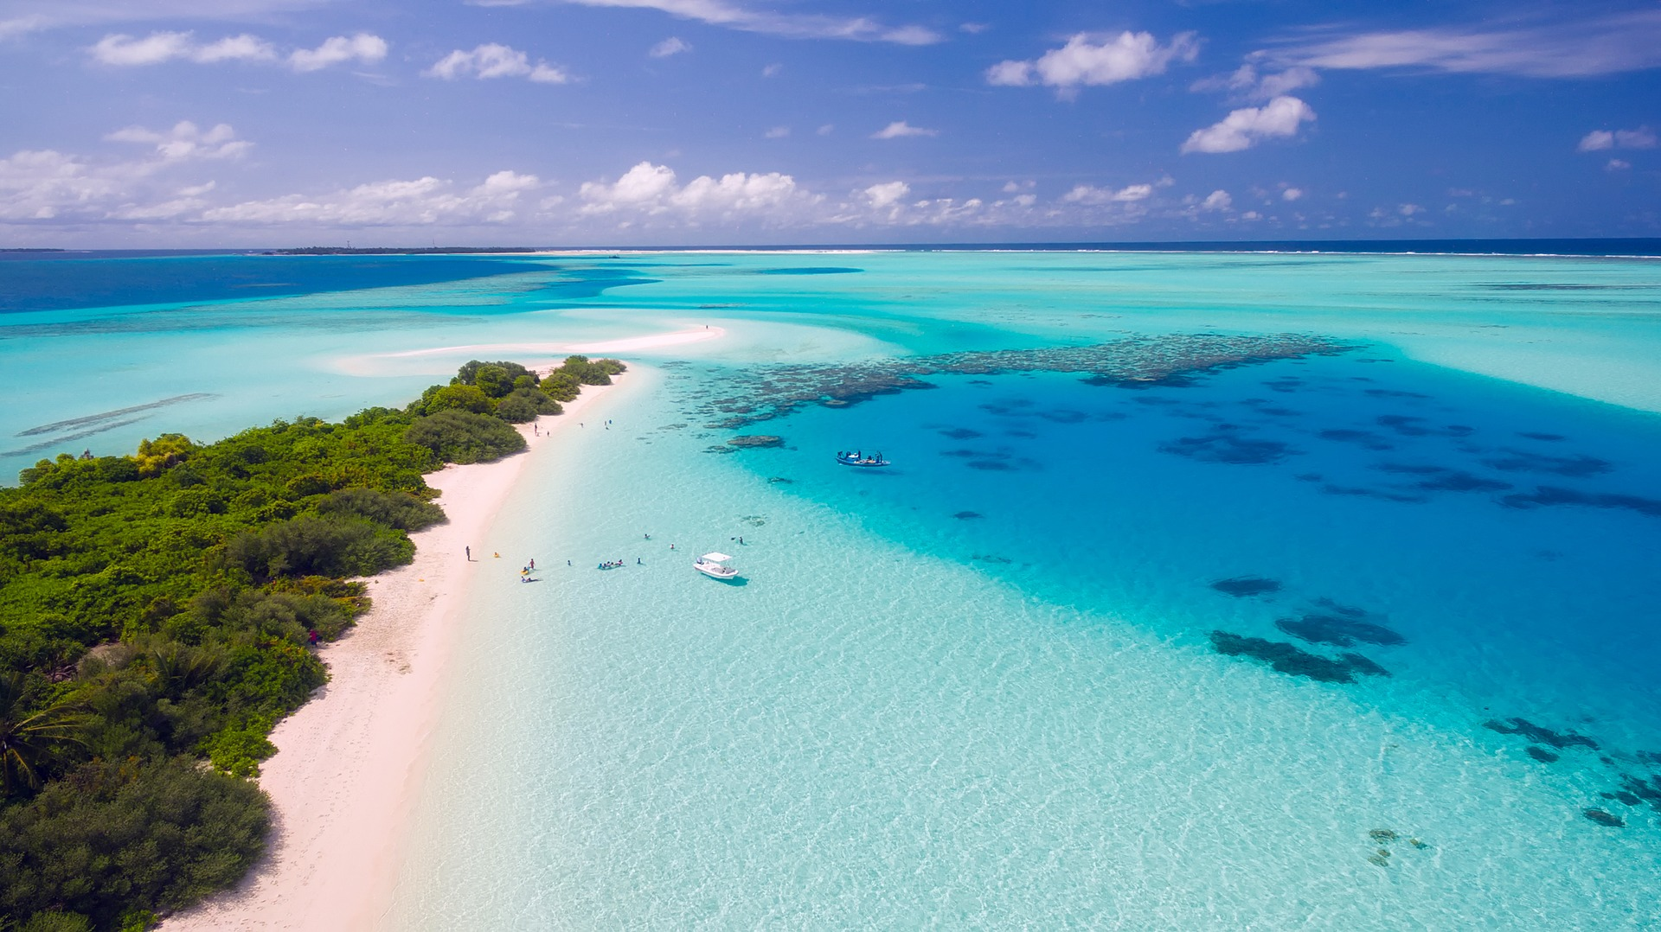
Oceans
www.ecosystemforkids.com

Slide 2
What is an ocean ?
It is the vast body of salt water that covers almost three fourths of the earth's surface.
There are 5 major oceans as follows:
Arctic
Atlantic
Indian
Pacific
Southern

Slide 3
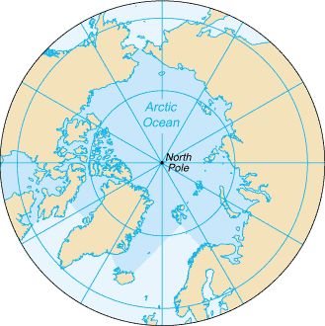
Arctic Ocean
Located mostly in the Arctic north polar region in the middle of the Northern Hemisphere, the Arctic Ocean is almost completely surrounded by Eurasia and North America. It is partly covered by sea ice throughout the year and almost completely in winter.
The Arctic Ocean is the smallest and shallowest of the world's five major oceans.
The Arctic Ocean occupies a roughly circular basin and covers an area of about 14,056,000 km²(5,427,000 sq mi)

Slide 4
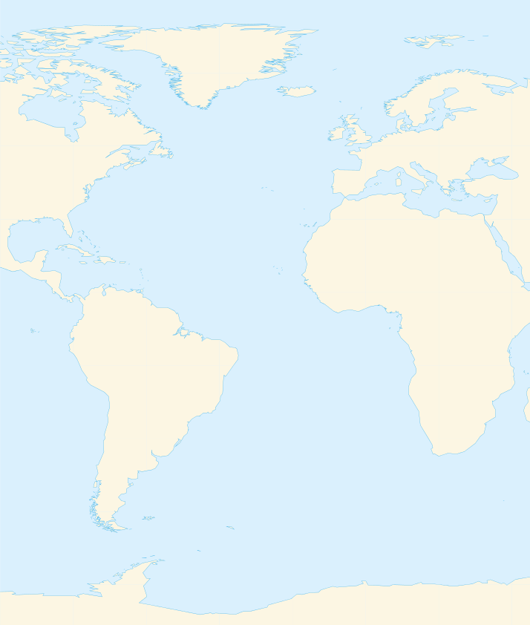
Atlantic Ocean
The Atlantic Ocean is the second largest of the world's oceans with a total area of about 106,460,000 square kilometers (41,100,000 square miles)
It covers approximately 20 percent of the Earth's surface and about 29 percent of its water surface area.
It separates the "Old World" from the "New World“
Max. depth: 8,486 m (27,841 ft)

Slide 5
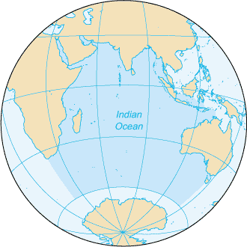
Indian Ocean
The Indian Ocean is the third largest of the world's oceanic divisions, covering 70,560,000 km2 (27,240,000 sq mi) (approximately 20% of the water on the Earth's surface)
it has an average depth of 3,741 m (12,274 ft) and a maximum depth of 7,906 m (25,938 ft)

Slide 6
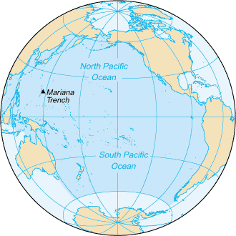
Pacific Ocean
The Pacific Ocean is the largest and deepest of Earth's oceanic divisions.
Surface area 165,250,000 square kilometers (63,800,000 square miles)
It covers about 46% of Earth's water surface and about one-third of its total surface area, making it larger than all of Earth's land area combined.
Its mean depth is 4,280 meters (14,040 feet). The Mariana Trench in the western North Pacific is the deepest point in the world, reaching a depth of 10,911 meters (35,797 feet).

Slide 7
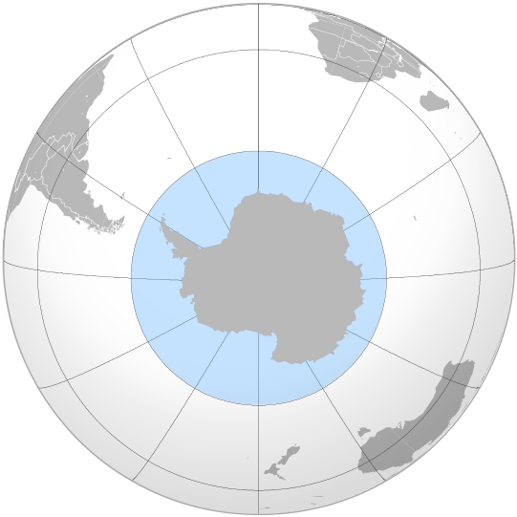
Southern Ocean
The Southern Ocean, also known as the Antarctic Ocean or the Austral Ocean.
It is regarded as the fourth-largest of the five principal oceanic divisions.

Slide 8
www.ecosystemforkids.com
Science Games | Worksheets | PowerPoints
Sources of images
By CIA - CIA World Factbook (https://www.cia.gov/library/publications/the-world-factbook/geos/xq.html), Public Domain, https://commons.wikimedia.org/w/index.php?curid=7627324
By Catrin - Own work, Using GMT, CC BY-SA 3.0, https://commons.wikimedia.org/w/index.php?curid=9777702
By United States Central Intelligence Agency - The World Factbook, Public Domain, https://commons.wikimedia.org/w/index.php?curid=89448
By CIA World Factbook - CIA World Factbook, Public Domain, https://commons.wikimedia.org/w/index.php?curid=7627409
By Connormah - Own work by uploader, based on File:Location Antarctica.svg, CC BY-SA 3.0, https://commons.wikimedia.org/w/index.php?curid=8029654

