Slide 1


Grade 10 Physics Unit 1
Explore the fundamental concepts of physics, from classical mechanics to modern quantum theory. Delve into the laws of motion, energy, and matter, and uncover the underlying principles that govern the natural world.
www.ecosystemforkids.com

Slide 2
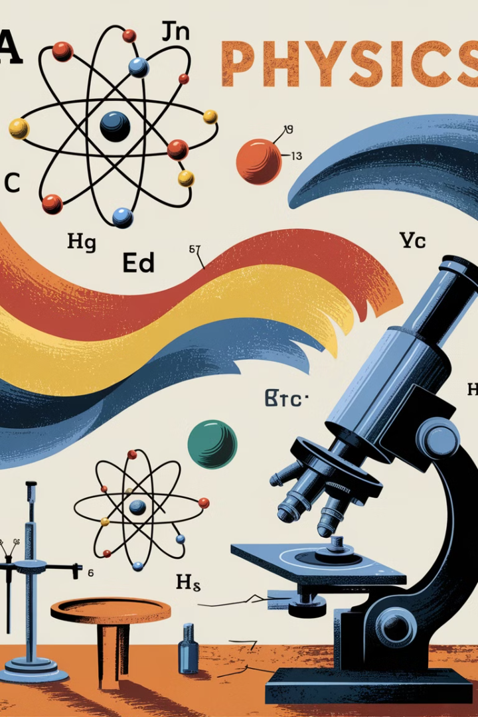



Introduction to Physics
Understand the Natural World
Physics is the study of the fundamental laws of nature and the interactions between matter and energy.
Quantify and Measure
Physics relies on scientific methods to make observations, formulate theories, and quantify natural phenomena.
Explain the Universe
From the smallest subatomic particles to the largest structures in the cosmos, physics seeks to explain it all.

Slide 3
The Scientific Method
Observe
1
Identify a problem or question to investigate.
Hypothesize
2
Propose a possible explanation or solution.
Experiment
3
Design and conduct tests to gather data.
Analyze
4
Examine the data and draw conclusions.
The scientific method is the fundamental process used by scientists to investigate the natural world. It involves a systematic series of steps to make observations, form hypotheses, design experiments, collect and analyze data, and draw conclusions. This rigorous approach ensures that scientific findings are based on evidence and can be replicated.

Slide 4

Measurement and Units
Fundamental Units
Derived Units
The fundamental units of measurement in physics are the base units of the International System of Units (SI): meter, kilogram, second, ampere, kelvin, mole, and candela.
Derived units are formed by combining the base units, such as Newton for force, Joule for energy, and Watts for power, allowing us to measure complex physical quantities.
Precision and Accuracy
Careful measurement technique and appropriate use of measuring instruments are crucial to obtaining precise and accurate data for scientific analysis and calculations.

Slide 5

Significant Figures
Significant figures refer to the meaningful digits in a measurement that indicate the precision of the value. They include all certain digits plus the first uncertain digit.
Example
Significant Figures
12.34 m
4
0.0067 s
2
5,000 kg
1
Proper use of significant figures is crucial for reporting measurements and performing calculations with them.

Slide 6





Dimensional Analysis
Identify Units
Examine the units of the given quantities to understand the physical dimensions involved.
Set Up Ratios
Arrange the units in the form of fractions, with the desired units as the numerator and the given units as the denominator.
Cancel Out Units
Systematically cancel out units in the numerator and denominator to arrive at the desired unit.
Evaluate Expression
Perform the necessary calculations using the remaining units and numerical values.

Slide 7


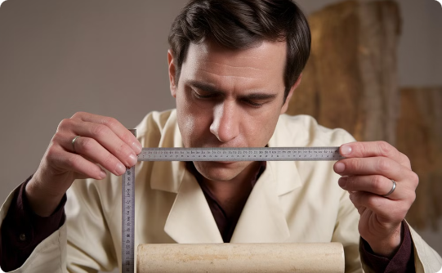
Conversions and Unit Prefixes
Unit Conversions
Metric Prefixes
Precision Measurement
Efficiently convert between different units of measurement, such as meters to feet or kilograms to pounds, using common conversion factors.
Understand the meaning and use of metric prefixes like kilo-, centi-, and milli- to easily express very large or very small quantities.
Utilize appropriate units and number of significant figures when recording and reporting measurements to convey the level of precision.

Slide 8
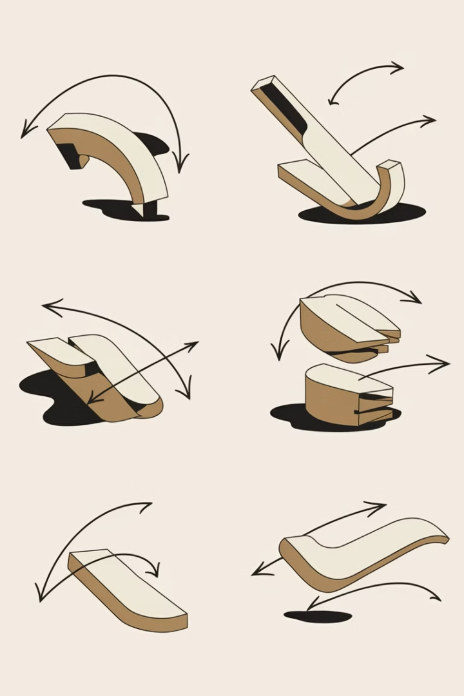
Kinematics in One Dimension
Explore the fundamental concepts of motion in one dimension, including displacement, velocity, and acceleration.

Slide 9
Displacement, Velocity, and Acceleration
Displacement
Velocity
Acceleration
Displacement is the change in an object's position from its starting point to its ending point. It represents the straight-line distance an object has traveled, regardless of the path taken.
Velocity is the rate of change in an object's position over time. It has both a magnitude (speed) and a direction. Velocity describes how fast and in what direction an object is moving.
Acceleration is the rate of change in an object's velocity over time. It represents how quickly an object's speed and/or direction is changing. Acceleration can be positive, negative, or zero.

Slide 10
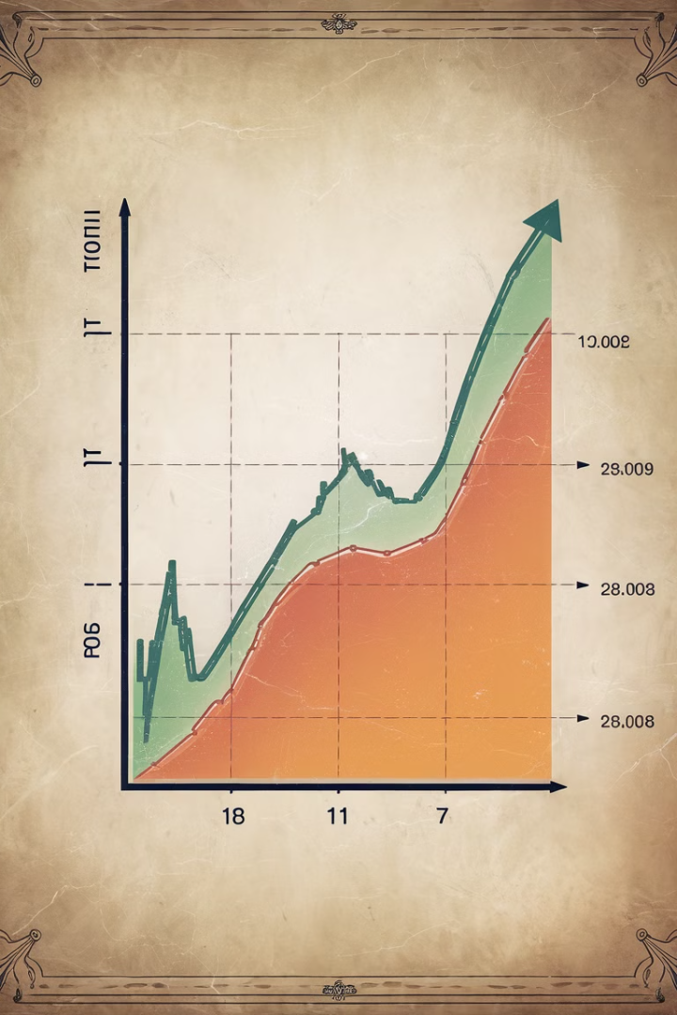
Graphing Motion
Graphs are a powerful tool for visualizing and analyzing the motion of objects. By plotting position, velocity, and acceleration over time, we can gain insights into the dynamics of the system and make quantitative measurements.
Carefully constructing and interpreting these graphs is a key skill in physics and helps us understand how objects move in one dimension.

Slide 11
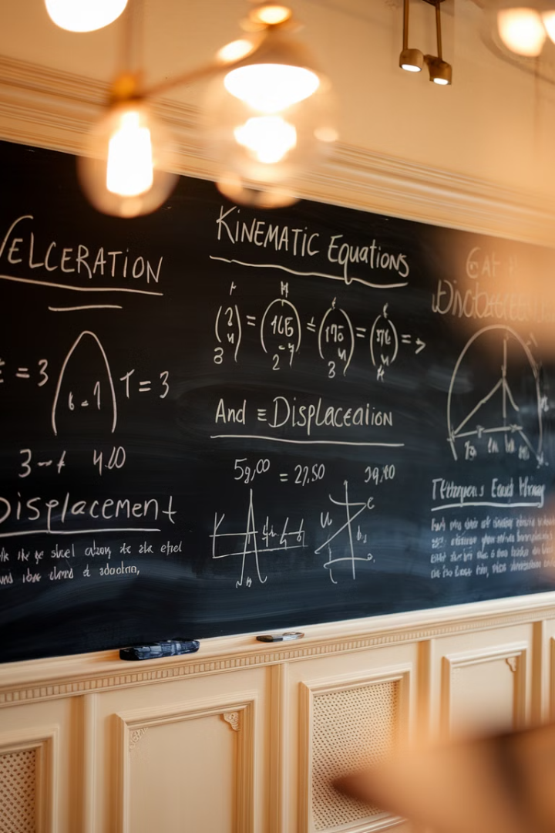
Equations of Motion
1
Displacement and Velocity
The equations for displacement and velocity are critical for understanding and analyzing one-dimensional motion.
2
Acceleration
Acceleration equations describe the rate of change in velocity, which is essential for predicting the motion of objects.
3
Problem Solving
These equations can be rearranged and combined to solve a variety of physics problems involving motion.

Slide 12

Free Fall and Gravity
1
Acceleration Due to Gravity
2
Negligible Air Resistance
In the absence of air resistance, all objects fall at the same rate, regardless of their mass or shape.
Objects in free fall experience a constant acceleration of approximately 9.8 m/s² towards the Earth's surface, known as the acceleration due to gravity.
3
Equations of Motion
4
Real-World Applications
The equations of motion can be used to describe the position, velocity, and acceleration of objects in free fall.
Understanding free fall is crucial for applications like projectile motion, skydiving, and the design of various mechanical systems.

Slide 13
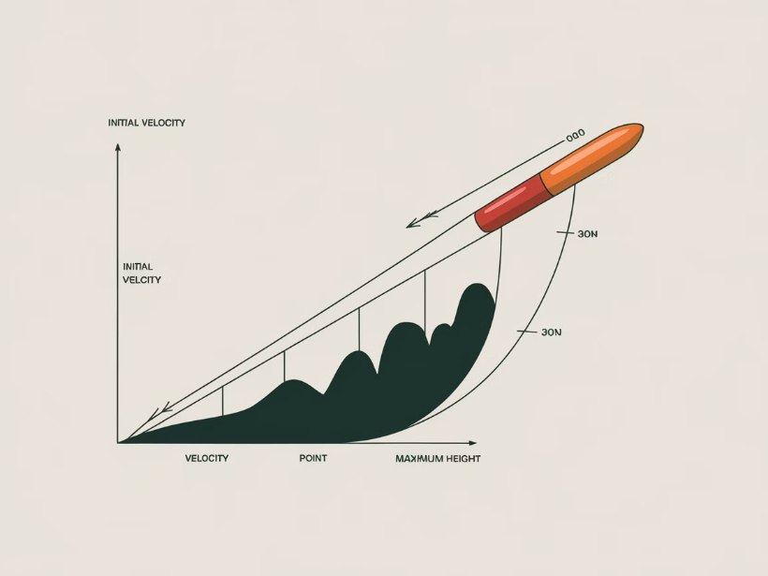
Projectile Motion
Projectile motion is the motion of an object that is launched into the air and follows a curved path under the influence of gravity. This includes anything from a ball kicked on a soccer field to a rocket launched into space.
Key factors in projectile motion include initial velocity, launch angle, and the effects of gravity and air resistance on the object's trajectory.

Slide 14
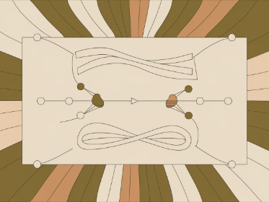
Vectors and Vector Addition
Understanding Vectors
Vector Addition
Components of Vectors
Vectors can be added together to find a single resultant vector that represents the combined effect. This is done using the principles of vector addition, which account for both the magnitude and direction of the individual vectors.
Vectors are mathematical representations of quantities that have both magnitude (size) and direction. They are essential in describing motion, forces, and other physical phenomena.
Vectors can be broken down into their horizontal and vertical components, which can then be used to calculate the overall magnitude and direction of the vector.

Slide 15
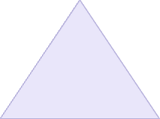



Components of Vectors
Magnitude
1
The scalar quantity representing the size or length of the vector
Direction
2
The orientation of the vector in space, typically described by angles
X-Component
3
The horizontal projection of the vector along the x-axis
Y-Component
4
The vertical projection of the vector along the y-axis
Vectors have two key properties - magnitude and direction. To fully describe a vector, we can break it down into its component parts along the x and y axes. The x-component and y-component represent the horizontal and vertical projections of the vector, respectively.

Slide 16
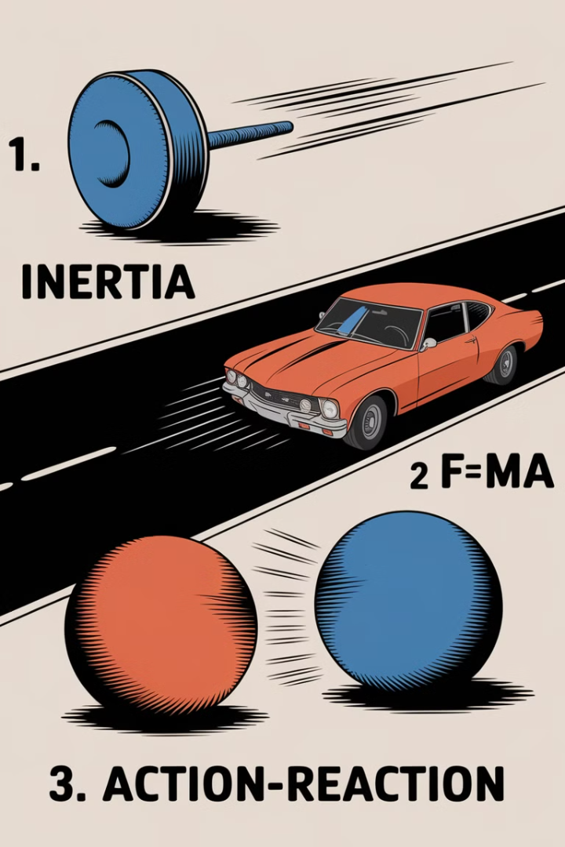
Newton's Laws of Motion
Understanding the fundamental principles that govern the motion of objects and the forces that act upon them.

Slide 17
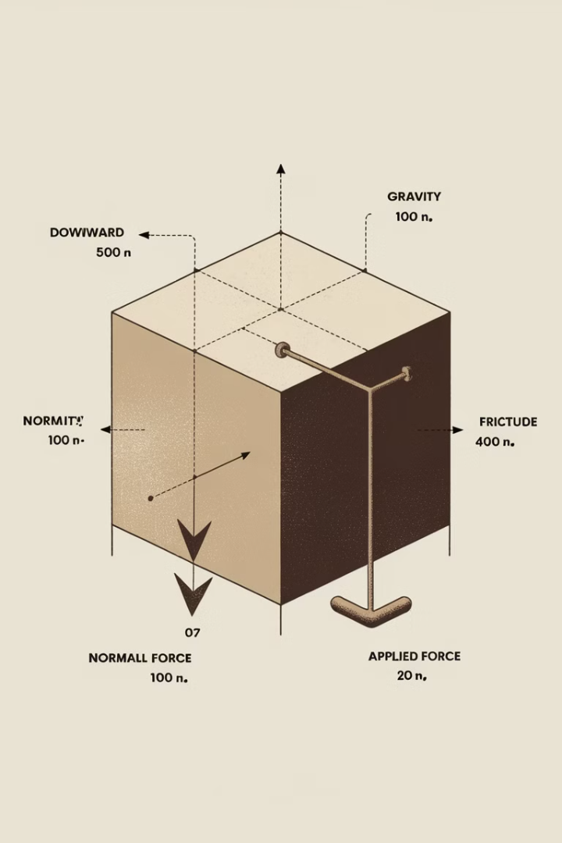
Forces and Free Body Diagrams
Understanding Forces
Free Body Diagrams
Forces are interactions that can cause an object to change its velocity, shape, or direction. They are fundamental to understanding how objects move and interact in the physical world.
A free body diagram is a visualization tool that shows all the forces acting on an object. It helps identify the net force and understand the object's motion.
Identifying Force Types
Normal force
Friction force
Tension force
Gravitational force

Slide 18
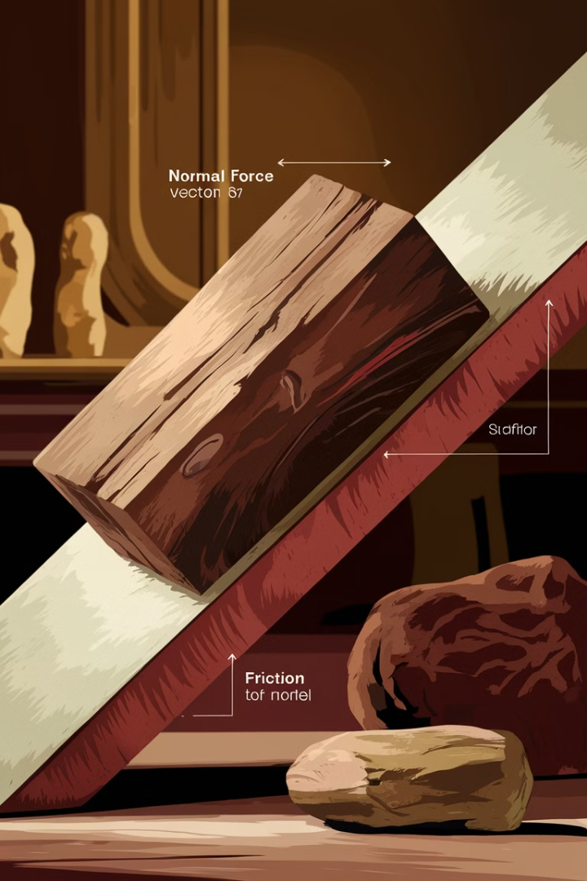
Friction and Normal Forces
Friction is the force that opposes the relative motion between two surfaces in contact. The normal force is the force exerted perpendicular to the surfaces in contact. The combination of these forces determines the behavior of objects in motion.
Friction acts in the opposite direction of motion and depends on the coefficient of friction and the normal force. The normal force is equal to the weight of the object and acts perpendicular to the surface.

Slide 19
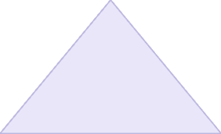
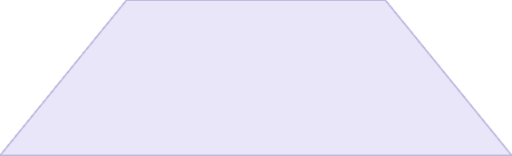
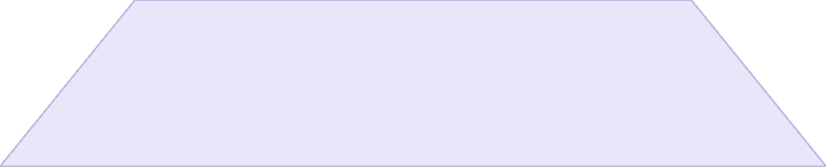
Work and Energy
Work
1
The transfer of energy through the application of force over a distance.
Kinetic Energy
2
The energy of motion, based on an object's mass and velocity.
Potential Energy
3
The stored energy an object has due to its position or state.
Work is a fundamental concept in physics, representing the transfer of energy through the application of force over a distance. This energy can manifest as kinetic energy, the energy of motion, or potential energy, the stored energy an object has due to its position or state. Understanding the relationship between work, kinetic energy, and potential energy is crucial for analyzing and predicting the behavior of physical systems.

Slide 20




Kinetic and Potential Energy
Kinetic Energy
Potential Energy
Energy Conversion
Kinetic energy is the energy an object possesses due to its motion. The faster an object moves, the more kinetic energy it has.
Potential energy is the energy an object has due to its position or state. This includes gravitational potential energy and elastic potential energy.
Energy can be converted between kinetic and potential forms. This is the basis for many physical processes and technological applications.

Slide 21
Work-Energy Theorem
Work
1
The transfer of energy through the application of a force over a distance.
Kinetic Energy
2
The energy of an object due to its motion.
Potential Energy
3
The energy of an object due to its position or configuration.
The work-energy theorem states that the work done on an object is equal to the change in the object's kinetic energy. This means that the work done on an object goes towards increasing its kinetic energy or changing its potential energy. This fundamental relationship is crucial for understanding and solving physics problems involving energy transformations.

Slide 22

Power
Power is the rate at which work is done or energy is transformed. It represents the efficiency and speed with which a task can be accomplished.
1kW
750W
Watt
Horsepower
5HP
1GW
Power Output
Gigawatt
The watt is the standard unit of power, representing one joule of work per second. Larger units like kilowatts and gigawatts are used to measure the output of powerful machinery and energy sources.

Slide 23
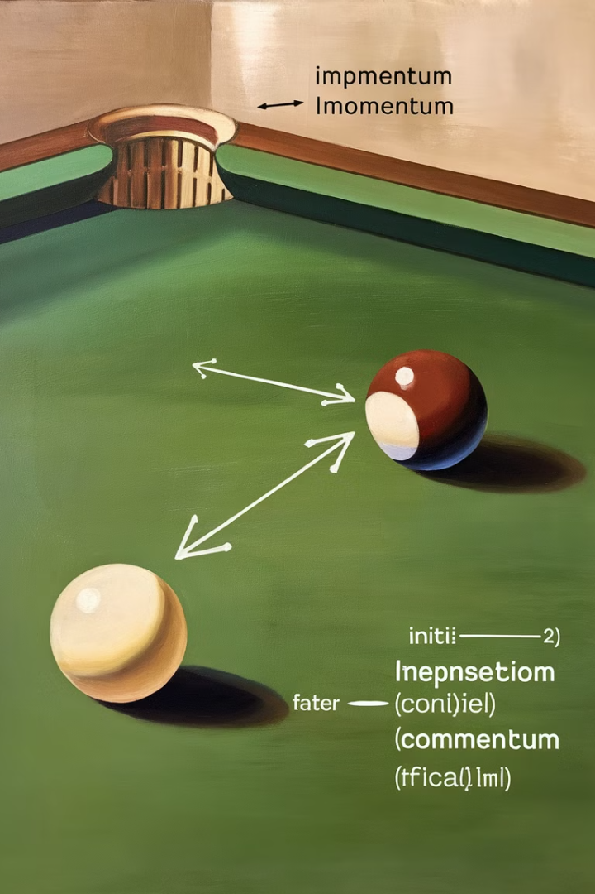
Momentum and Impulse
1
Momentum
2
Impulse
Momentum is the product of an object's mass and velocity, representing its quantity of motion.
Impulse is the change in momentum, caused by a force acting over a period of time.
3
Conservation of Momentum
4
Impulse-Momentum Theorem
The total momentum of a closed system is conserved unless an external force is applied.
The change in momentum of an object is equal to the impulse applied to it.

Slide 24
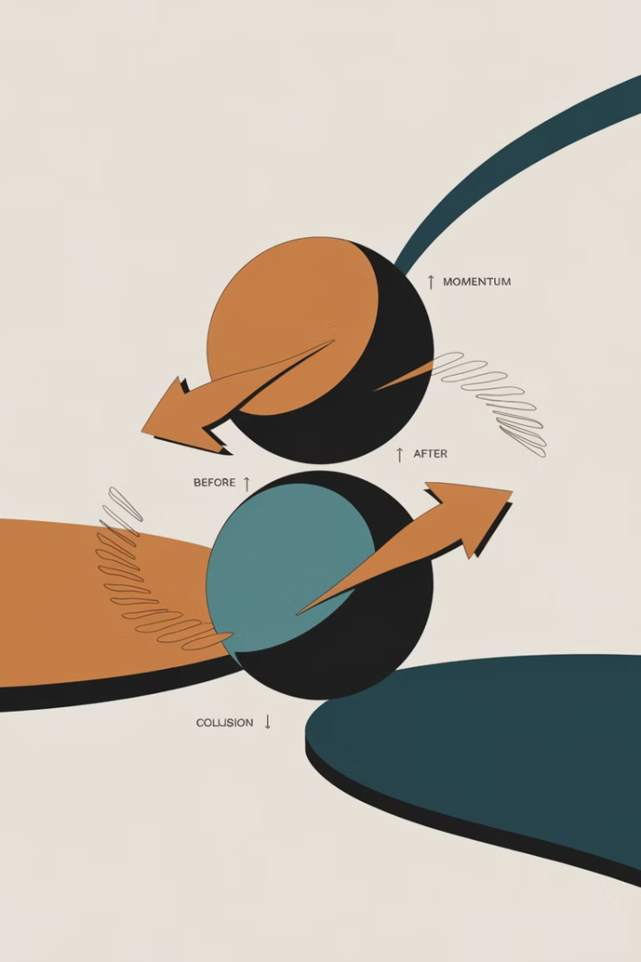
Conservation of Momentum
1
Defining Momentum
Momentum is the product of an object's mass and velocity. It represents the object's quantity of motion.
2
Conservation Principle
The law of conservation of momentum states that the total momentum of a closed system remains constant unless an external force acts on it.
3
Applying the Law
In collisions and other interactions, the total momentum of the system is conserved, even as individual momenta change.

Slide 25
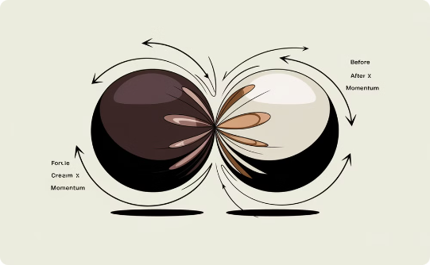
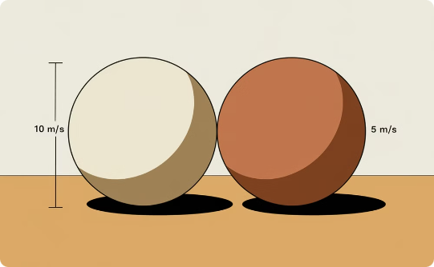

Collisions
Collision Dynamics
Conservation of Momentum
Collision Safety
When two objects collide, the forces and momenta involved determine the outcome. Understanding collision mechanics is key to analyzing real-world situations.
In a closed system, the total momentum before a collision is equal to the total momentum after the collision, unless an external force is applied.
Designing vehicles and structures to absorb collision energy through controlled deformation can minimize injury and damage during accidents.

Slide 26

Circular Motion and Centripetal Force
When an object moves in a circular path, it experiences a centripetal force that constantly pulls it towards the center. This force changes the direction of the object's velocity, causing it to follow a curved trajectory.
Centripetal force can arise from various sources, such as tension, friction, or gravity. Understanding circular motion and centripetal force is crucial in fields like astronomy, engineering, and sports.

Slide 27
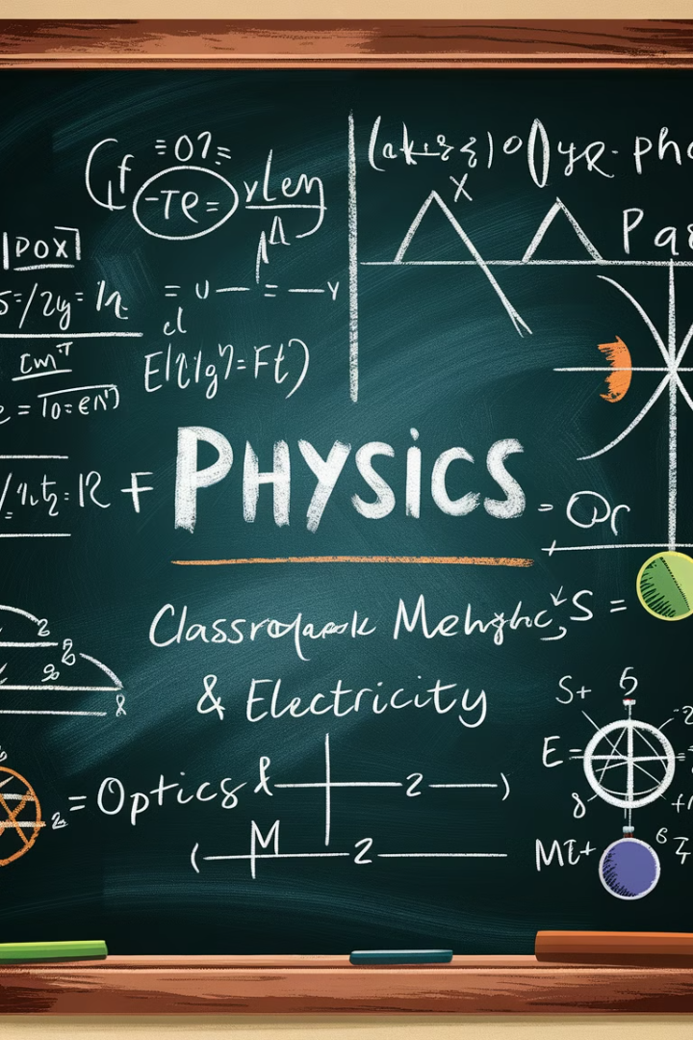
Conclusion and Review
In this final section, we'll summarize the key concepts covered in Grade 10 Physics Unit 1 and provide a high-level review of the essential topics. This will help solidify your understanding and prepare you for the upcoming assessments.

