Slide 1
Ecosystems
www.ecosystemforkids.com

Slide 2
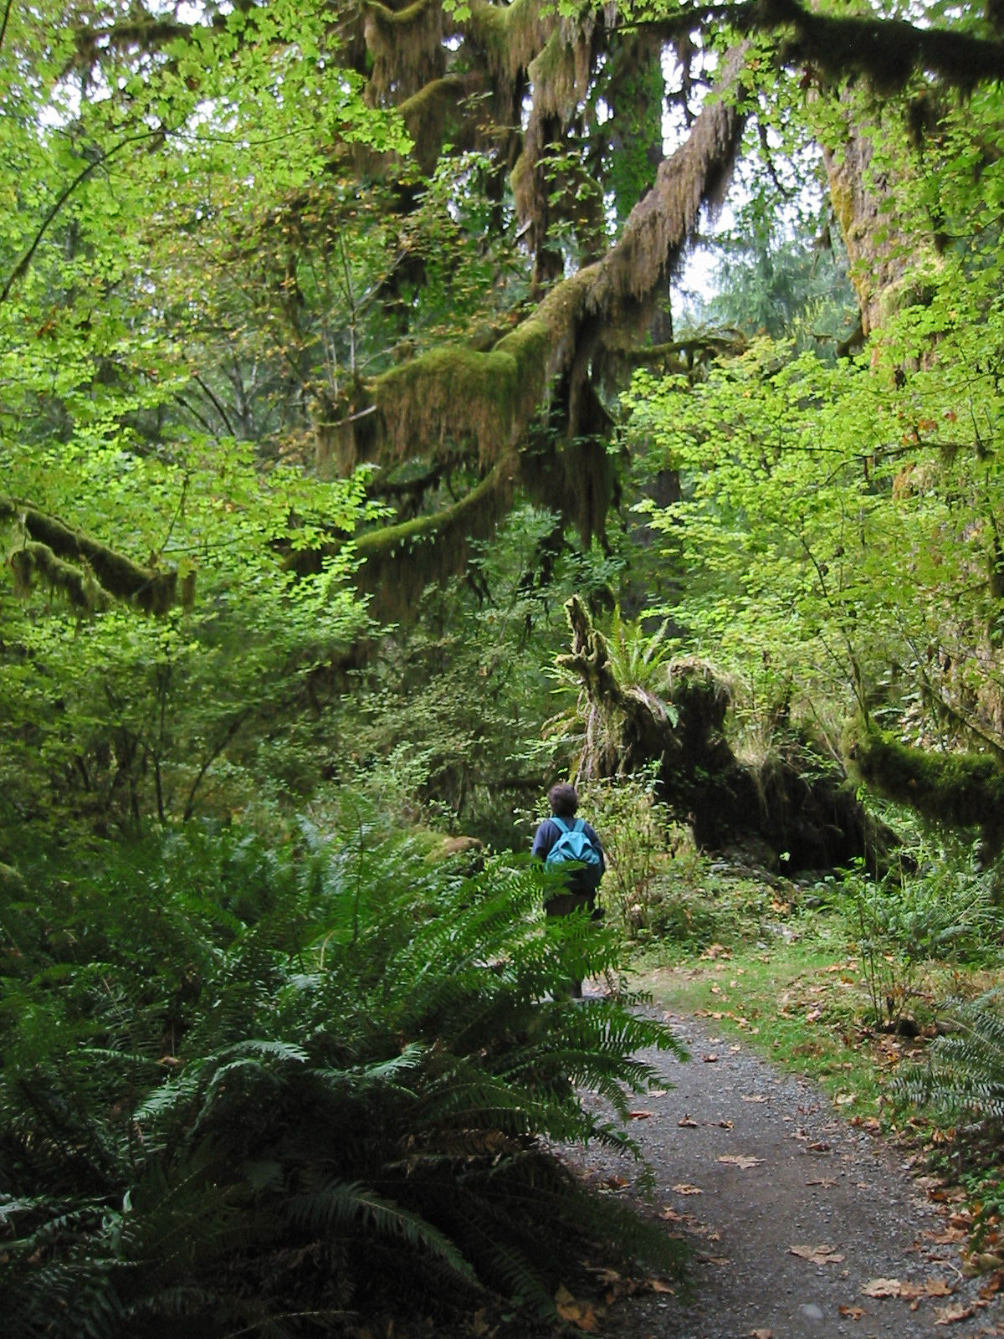
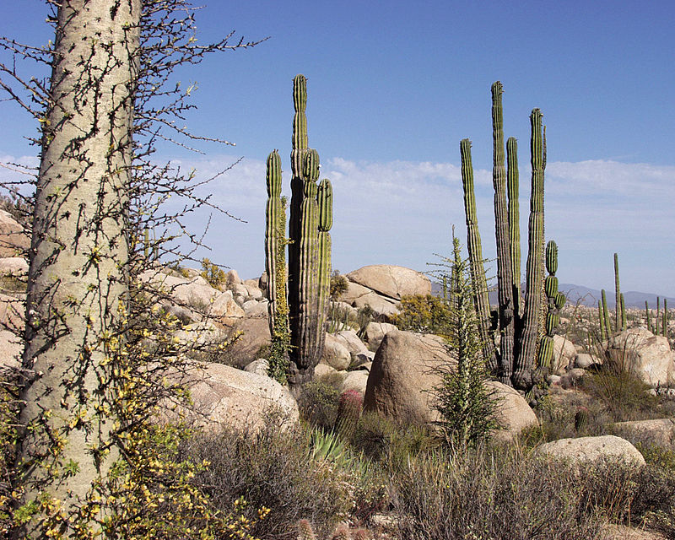
What is an ecosystem ?
An ecosystem is a large community of living organisms (plants, animals and microbes) in a particular area.
It is a biological community of interacting organisms and their physical environment.
The living and physical components are linked together through nutrient cycles and energy flows. Ecosystems can be of any size, but usually they are in particular places.
Examples: Forest Ecosystems, Grassland Ecosystems, Desert Ecosystems, Tundra Ecosystems, Freshwater Ecosystems, Marine Ecosystems

Slide 3
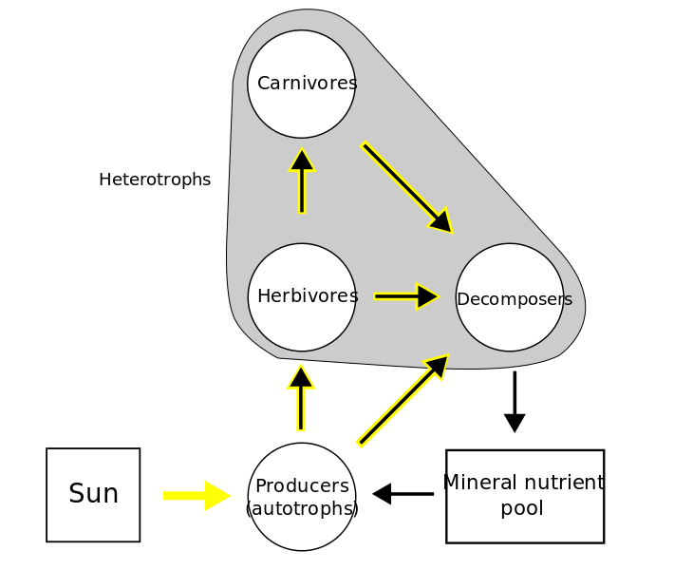
Ecosystem Diagram
Carnivores are animals that feed on other animals e.g. lion, tiger, vulture, fox etc.
Plants need sunlight for the process of photosynthesis. During photosynthesis plants use the energy of the sunlight, water, and carbon dioxide, to create glucose (sugar)
Herbivores are animals that feed on plants e.g. horse, deer, etc.
Decomposers are organisms, especially a soil bacterium, fungus, or invertebrate, that decomposes organic material.
Green plants are producers since they capture and convert the energy of the sun into food needed by organisms within ecosystems.
Decomposed plants and animals become soil and minerals needed by plants during photosynthesis.

Slide 4
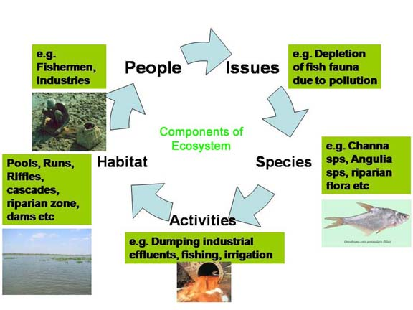
Man In The Ecosystem
Man plays an important role in the destruction of many ecosystems hence leading to the depletion and extinction of several species. Some of man’s irrational practices include: deforestation, fishing excessively, industrialization, hunting, dumping, poor farming practices and more.

Slide 5
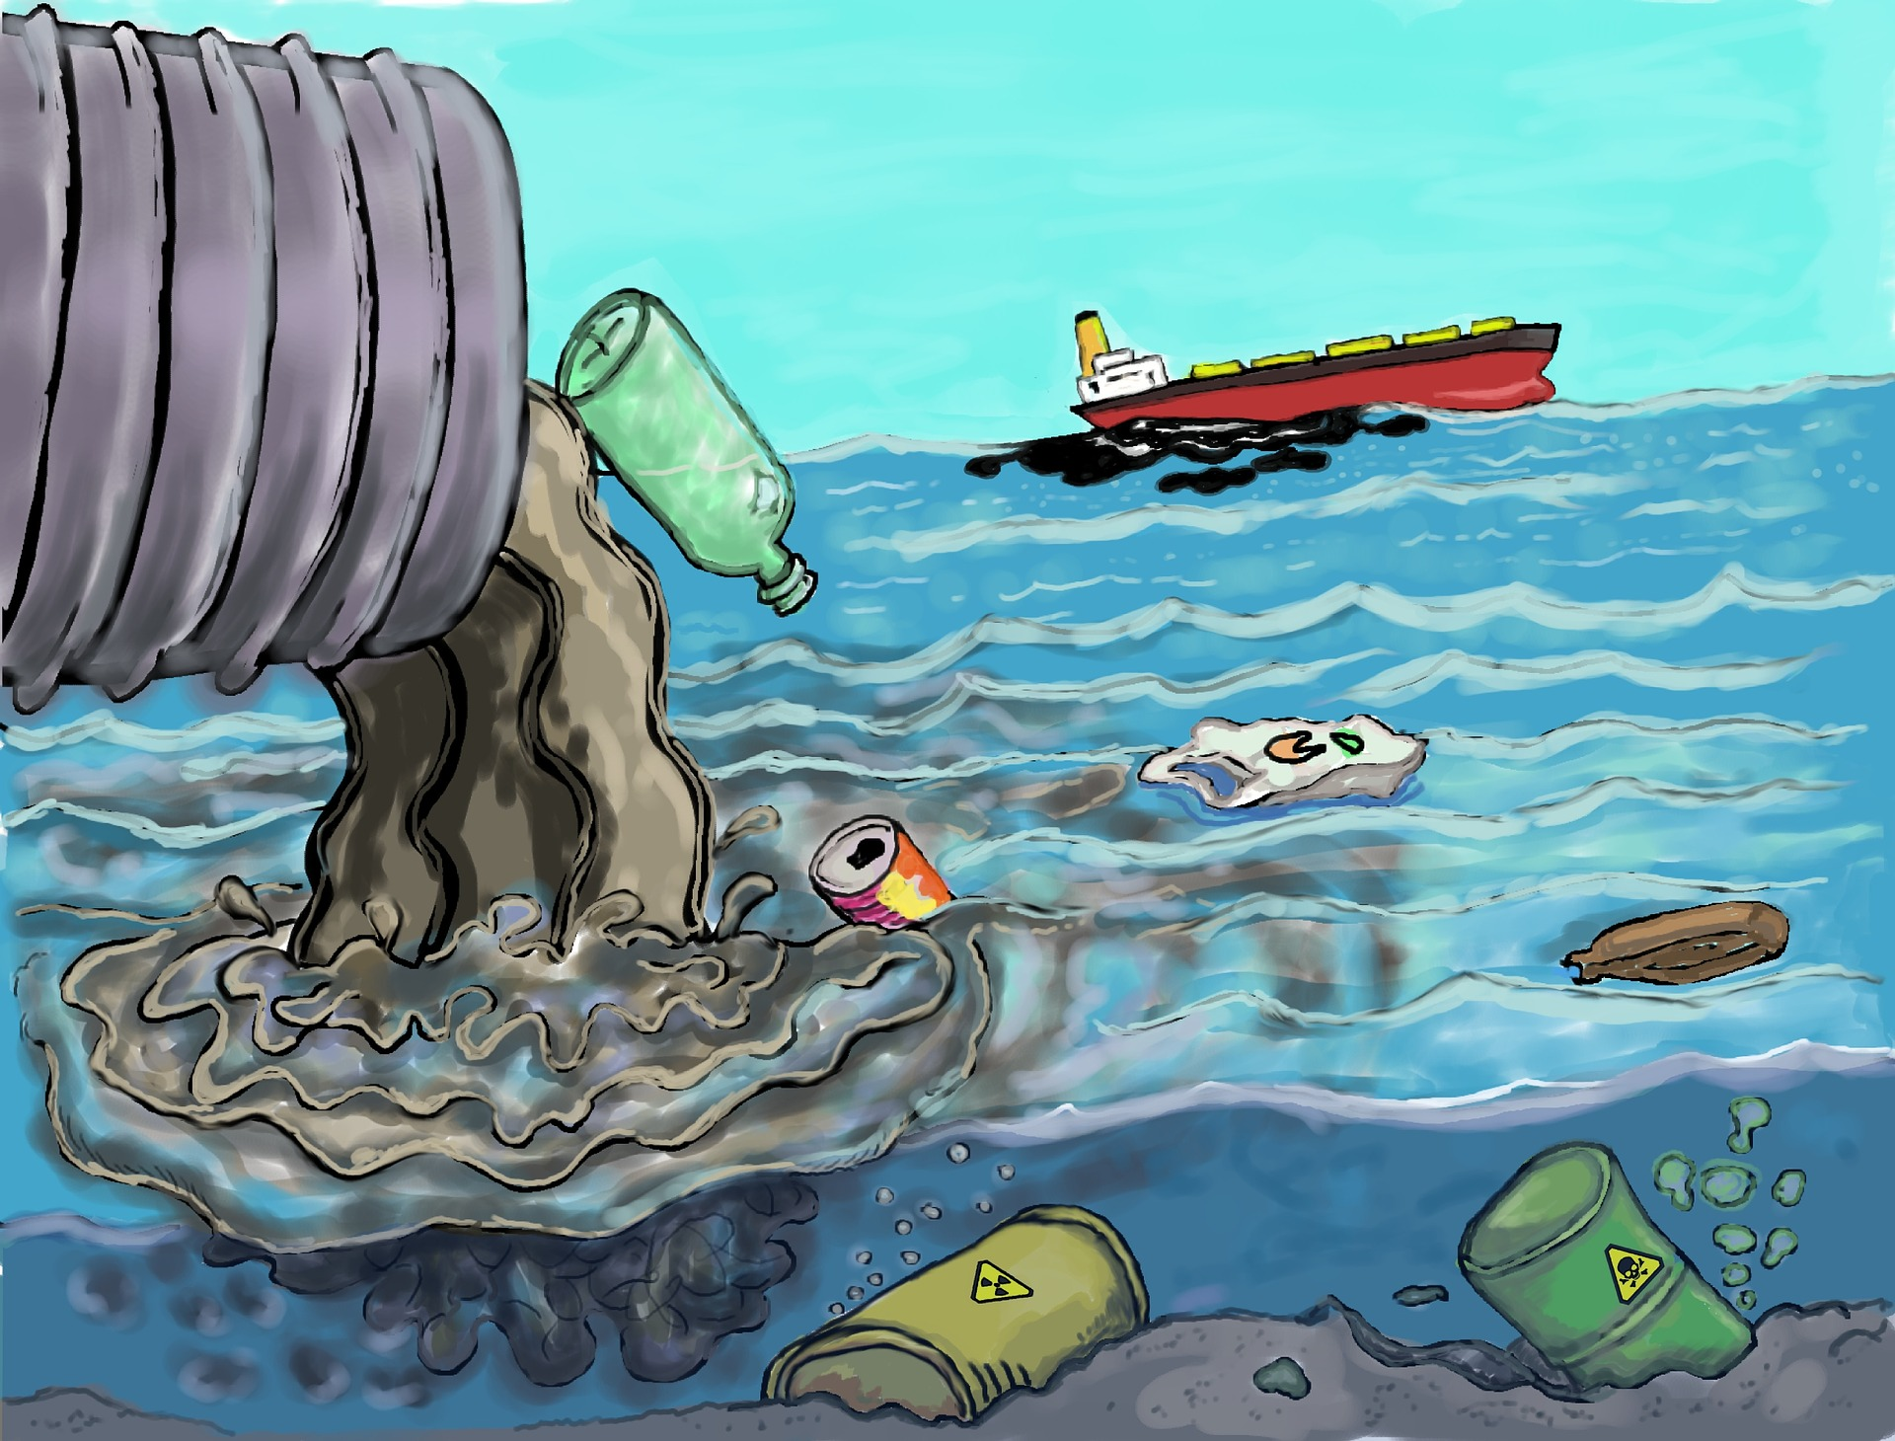
Man’s Impact On Ecosystems

Slide 6
Free science resources 1st – 6th grades
www.ecosystemforkids.com
Games | Quizzes | Worksheets | ppts

